Slide 1




University Questions…
With No Instant Answers
Students Struggle
Website Navigation
Find quick, accurate responses to university-related questions.
University websites can be overwhelming or difficult to navigate.
Limited Support
Staff availability is limited to working hours.

Slide 2






Meet Yarmouk Assistant Bot
Smart Assistant
Your go-to for Yarmouk questions.
Bilingual Support
Natural Arabic and English.
24/7 Availability
Always there when you need it.
Easy Access
Via Telegram and Website.

Slide 3





What Makes It Special?
High Accuracy
92% with AI intent detection.
Smart Understanding
Handles misspellings and variations.
Fast Answers
Instant replies within 1–3 seconds
Seamless Languages
Works in Arabic and English.

Slide 4
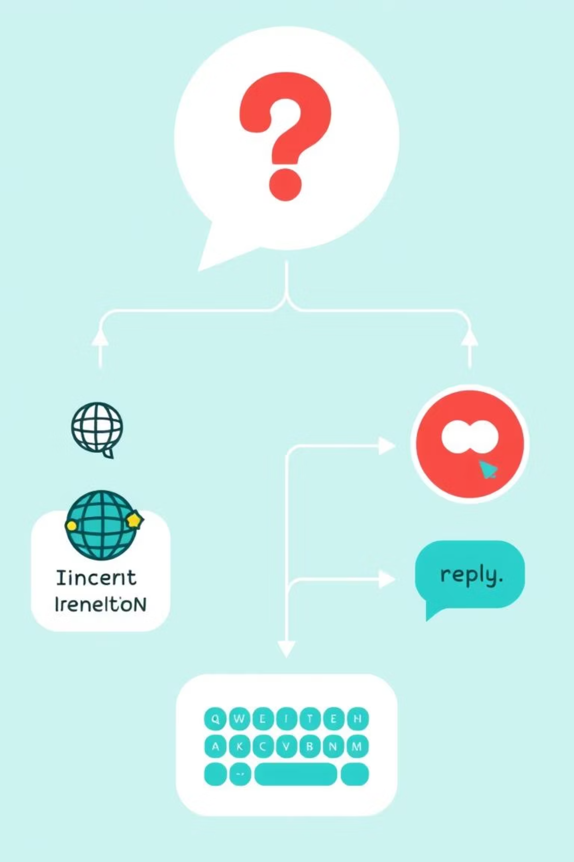





Smart Behind the Scenes
Detect Language
Corrects typos instantly.
Predict Intent
Uses AI for understanding.
Best Response
Provides the most relevant reply
Replies in Language
Consistent communication.

Slide 5
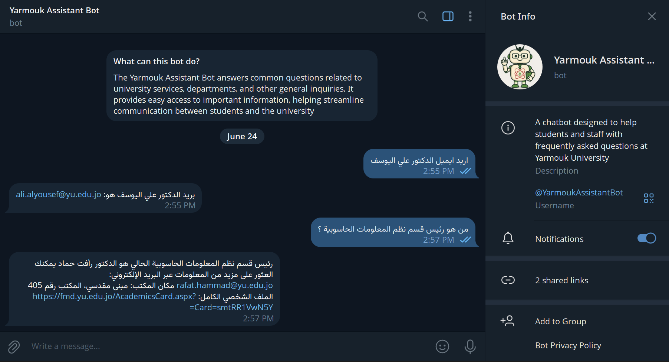
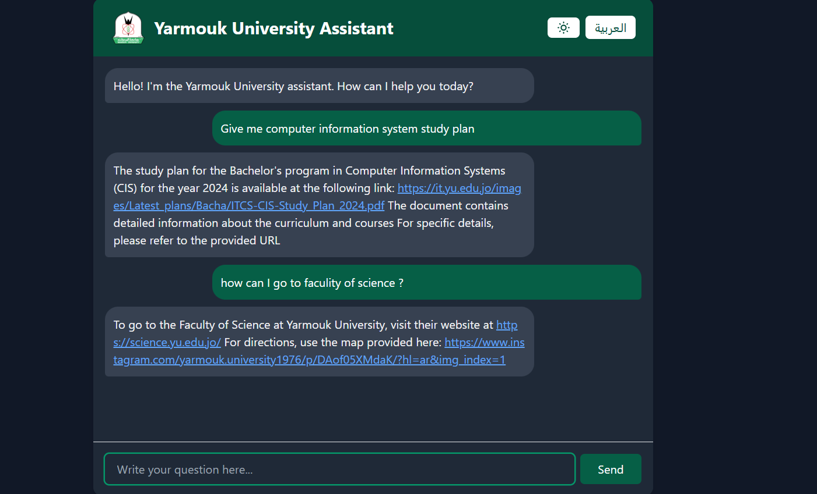

See It in Action
Ask about study plans.
Inquire about professors.
Find campus maps.
Any other questions
Get direct, clear answers.

Slide 6

Achievements and Vision
85%
Hundreds
Questions Automated
Active Users
Significant reduction in manual queries.
Growing student adoption.
Voice Support
Next-gen interaction.
Smarter Follow-ups
Enhanced conversational flow.
Expanded Topics
More comprehensive knowledge base.

Slide 7
THANK YOU

